Slide 1
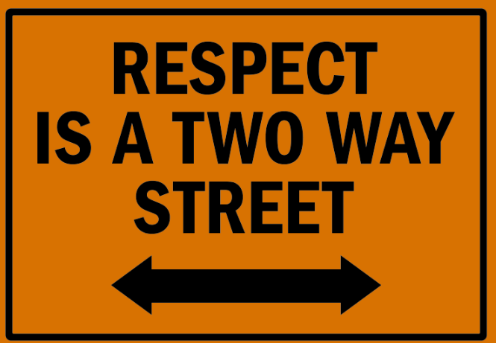
Respect
AUTUMN 1
Respect song

Slide 2
Welcome to our ‘Values’ assembly
A value is a principle that guides our thinking and behaviour

Slide 3
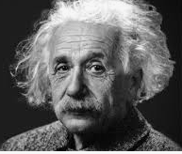
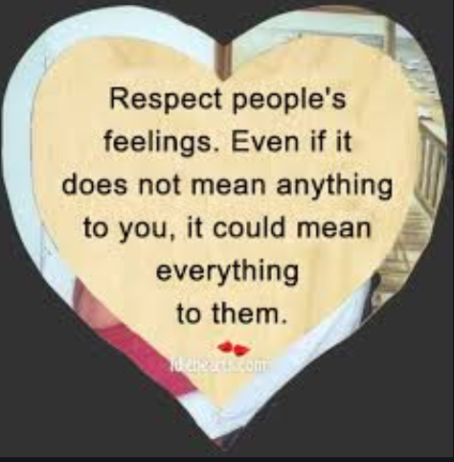
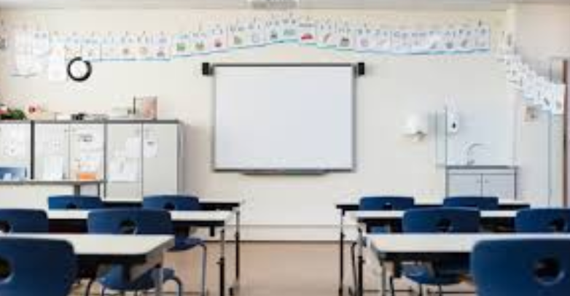
RESPECT
You can have respect for someone because you admire something about them
You can have respect for someone’s feelings, their wishes or their rights
You can have respect for things other than humans or things that aren’t living

Slide 4
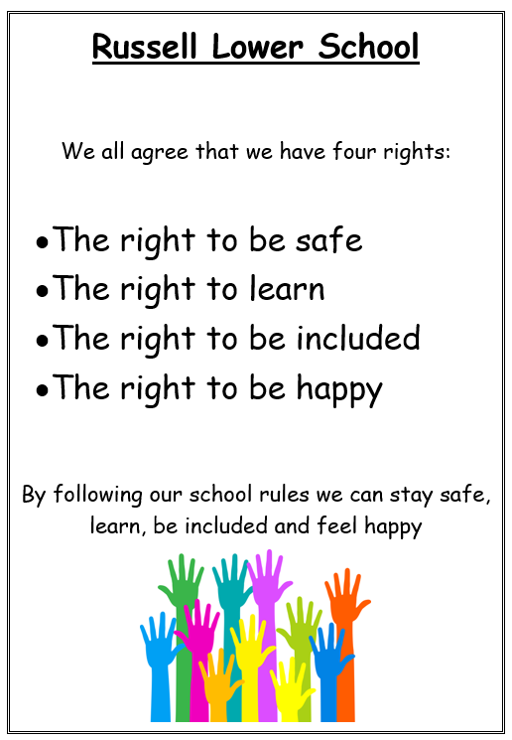
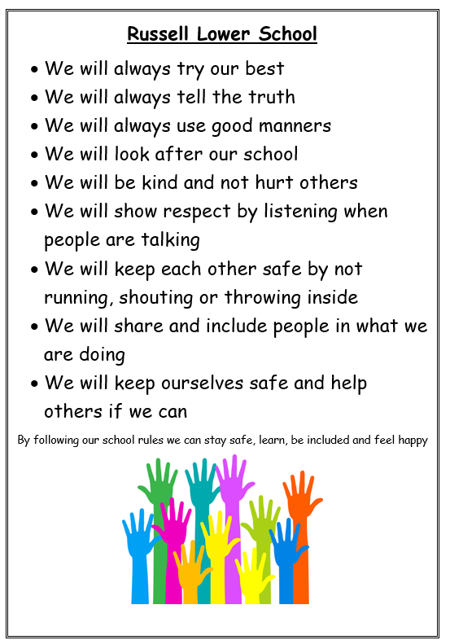
What do we have in school that helps us show respect?

Slide 5
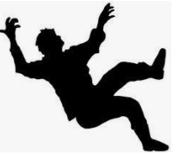
When you see someone fall over
Do you laugh?
Do you ignore them?
Do you call them unkind words?
These are disrespectful
What could you do?

Slide 6
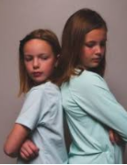
If you see someone you don’t get on with
Do you laugh at them?
Do you call them names?
Do you say nasty things about them?
Do you hit them?
These are disrespectful
What could you do?

Slide 7
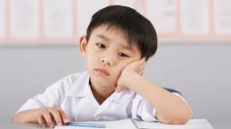
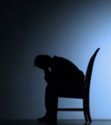
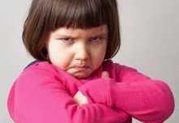
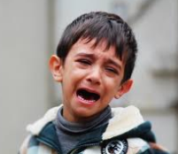
How would you feel
If someone shouted at you?
If someone hit you?
If someone called you names?
If someone took your belongings?

Slide 8
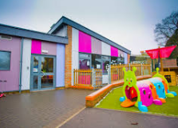
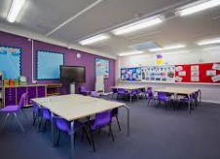
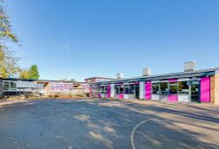
Respect for our school environment

Slide 9
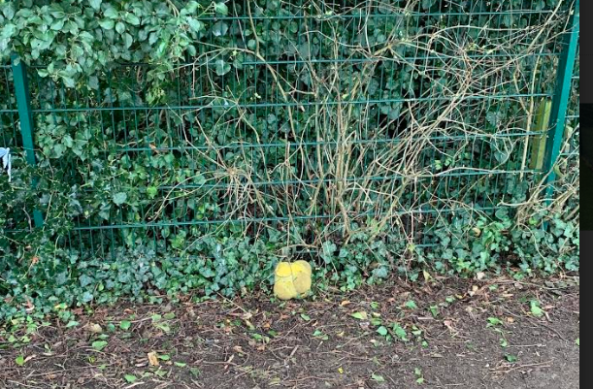
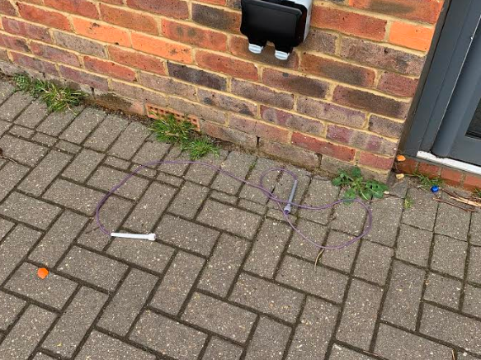
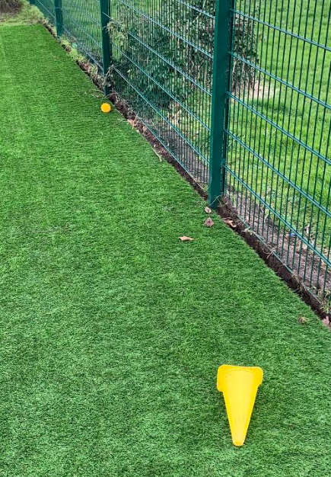
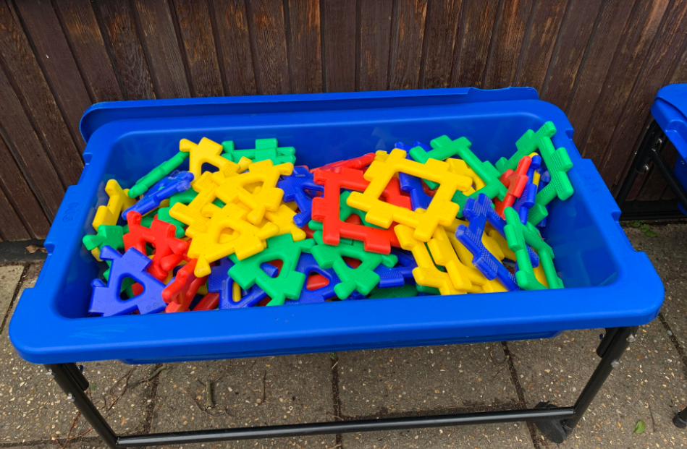
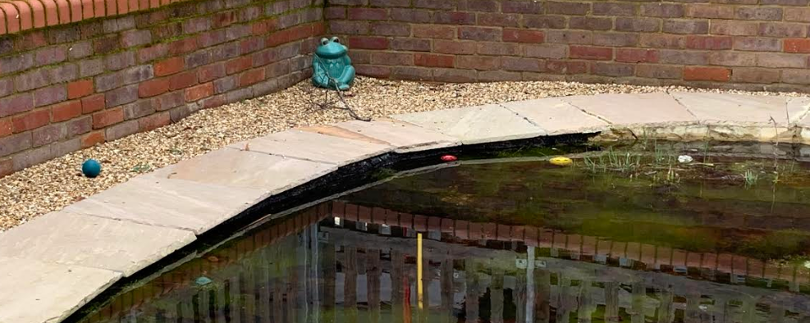
How can we be respectful towards our environment and equipment?

Slide 10
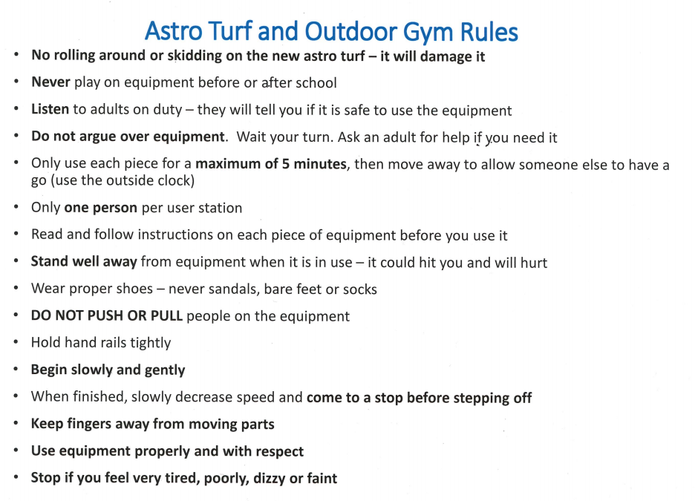
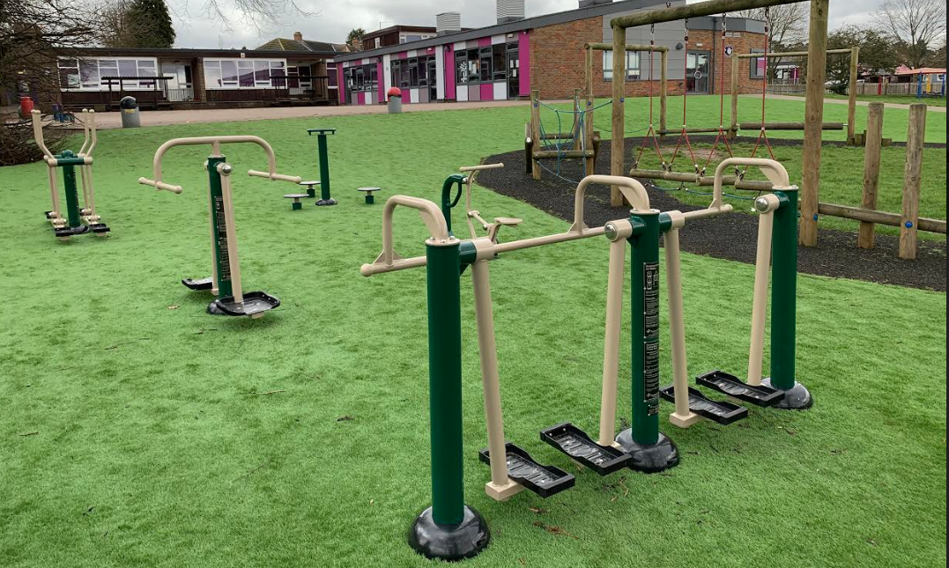
Respect for our environment

Slide 11
Why is respect important?
So we can all learn
So people feel included
So we are all safe
So we are all happy
It helps us to have:
a calm environment
a polite environment
a trusting environment
a tidy and well cared for environment
We need to earn respect and we do that through respecting others.

Slide 12
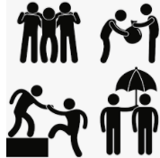
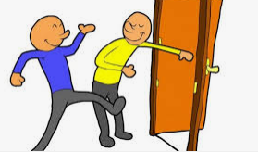
Treat other people how YOU would like to be treated.
Help people who need it
Listen to your friends
Hold open a door for someone
Smile at someone you don’t normally speak to
Ask someone to join you on the playground

Slide 13
How can we show respect?
following
rules
caring
listening
trusting
respecting ourselves
being reliable
keeping promises
being punctual
being polite
being fair

Slide 14
Reflect on how you can show respect to others

