Slide 1
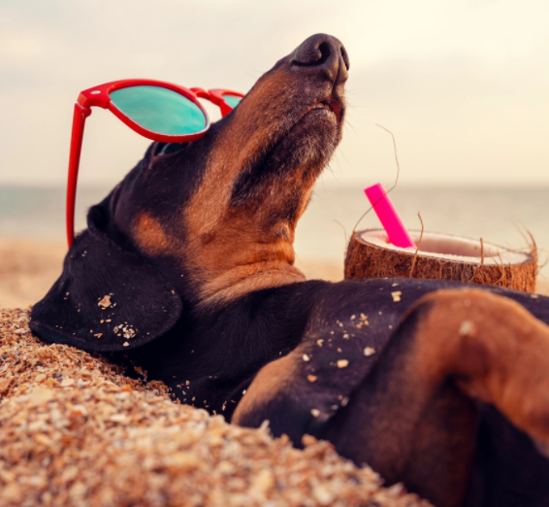
Welcome back to school! We hope you had a wonderful summer holiday.

Slide 2
Some assemblies will be back in the hall. Can we remember the rules? Come in one behind the other in a line without talking Sit in your class line (leave a gap in the middle) Sit with your legs crossed Sit with your hands in your lap No talking in assembly Eyes on the board or on the teacher

Slide 3
We are back at school now, and the government have stopped some restrictions, but there is still some of the virus around so we need to still be careful and:
Keep our windows and door open a lot of the time so we have good ventilation
Keep washing our hands properly and regularly
Keep sneezing into tissues or the crook of our arm (bent elbow)
Still eat in our classrooms sometimes
If we get Covid (or are poorly with anything else), we will still go home
Grown ups might still wear a face covering sometimes

Slide 4
We are doing these things to stop the virus spreading because it hasn’t completely gone away

Slide 5
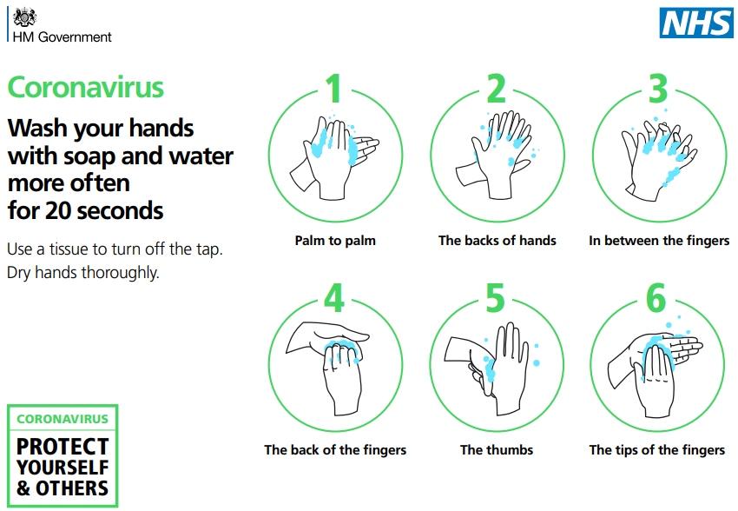
Remember to wash your hands properly. It keeps you and others safe

Slide 6
What is different at school now?
You are in your new classroom and year group
Your tables are in groups again…we don’t always have to face the front
You can play in any area of the playground. You don’t have to stick to ‘Zones’
Our whole year group will go out to play with us
You don’t have to stick with our bubbles any more
If someone in our class gets Covid, everyone in the class WON’T have to go home now
We can go into the toilets when we need to – not just with our bubble, but our teachers will tell us when we can
You can go into assemblies in the main hall
You can use the library again

Slide 7
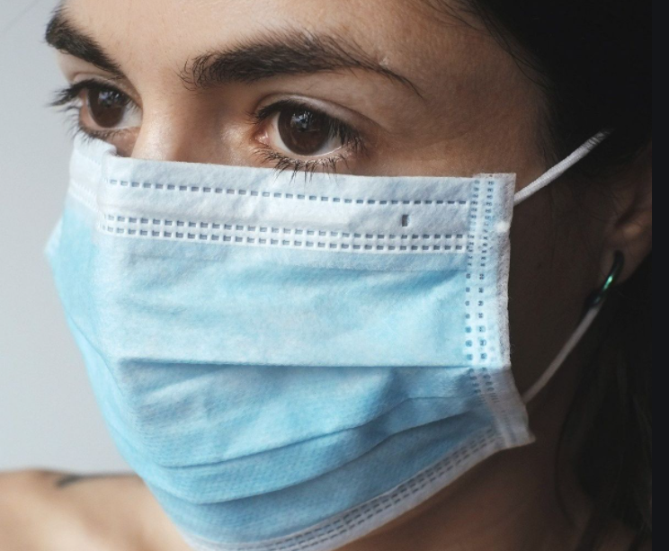
What if a lot of Covid comes back?
We might need adults to wear face coverings again
We might need to make class ‘bubbles’ again
We might need to go back to some of the things we did before
No problem!

Slide 8
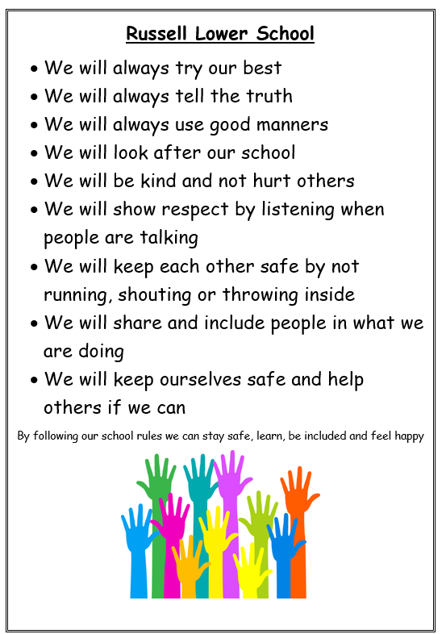
What is the same at school? Expectations!

Slide 9
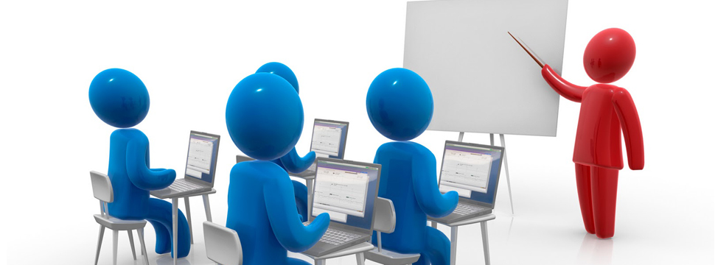
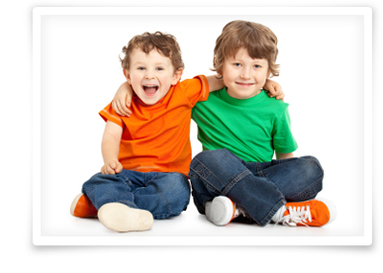
Everyone’s rights…
The right to learn
The right to be happy
The right to be safe
The right to be included

Slide 10
The right to be safe

Slide 11
The right to be safe
We are a ‘Telling School’

Slide 12
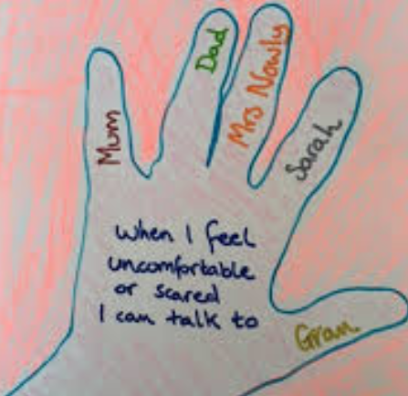
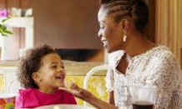
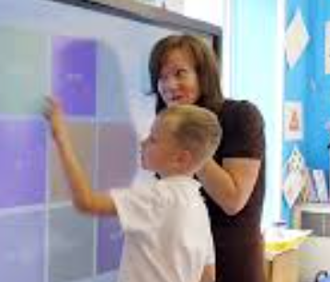
What do I do when I don’t feel safe?

