Slide 1


Slide 2
How did you travel to school today?
Notes:
Go though the following slides asking them to put their hands up if they travelled to school that morning via that mode

Slide 3
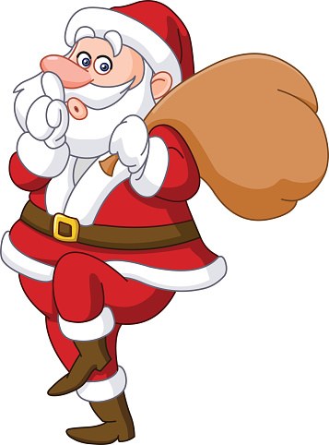
Walking?

Slide 4
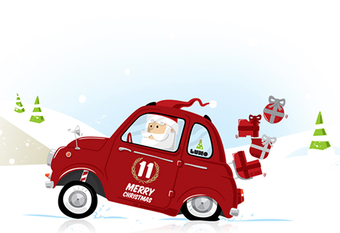
Car?

Slide 5
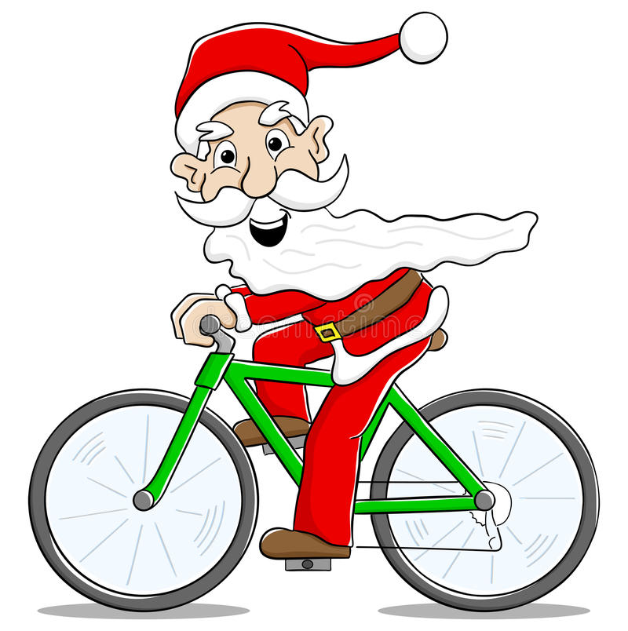
Cycle?

Slide 6
Bus?

Slide 7
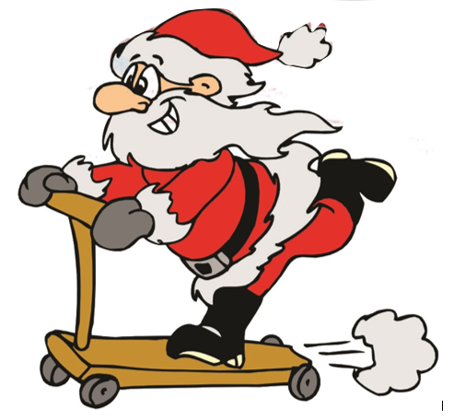
Scoot?

Slide 8
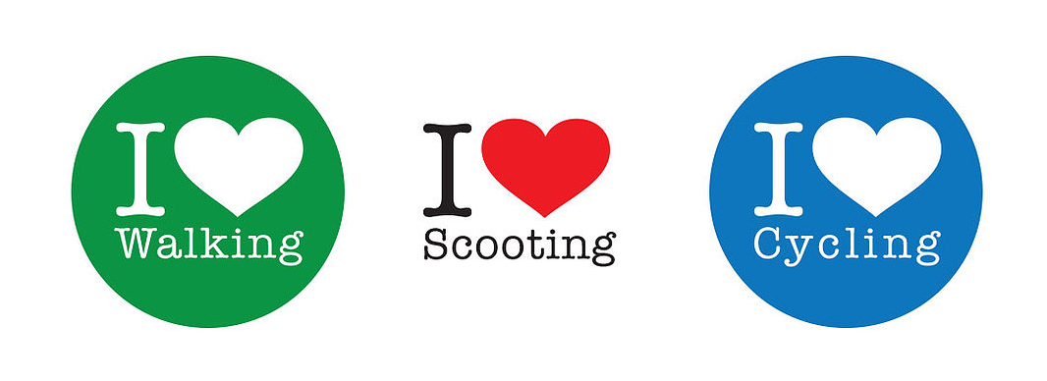
Why is scooting, cycling or walking good?
Notes:
Ask the pupils why they thing walking, cycling and scooting is good.

Slide 9
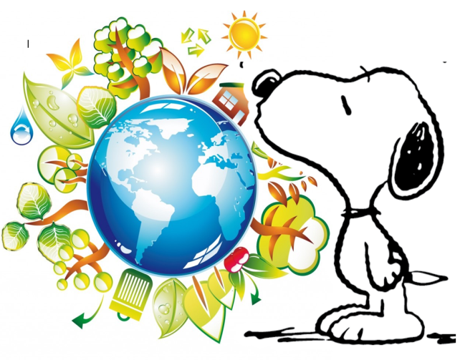
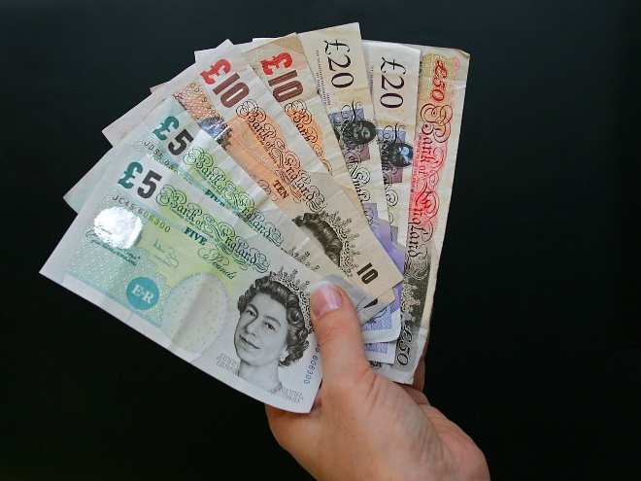
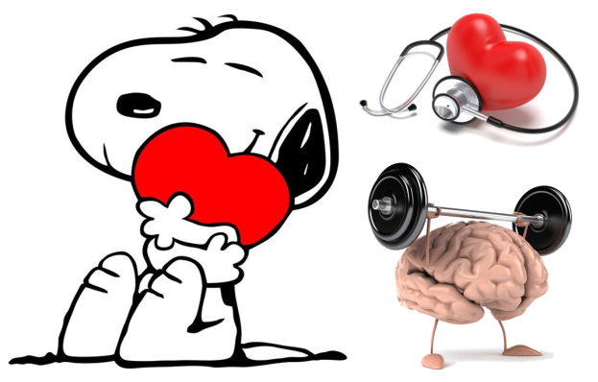
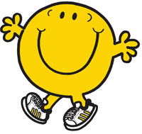
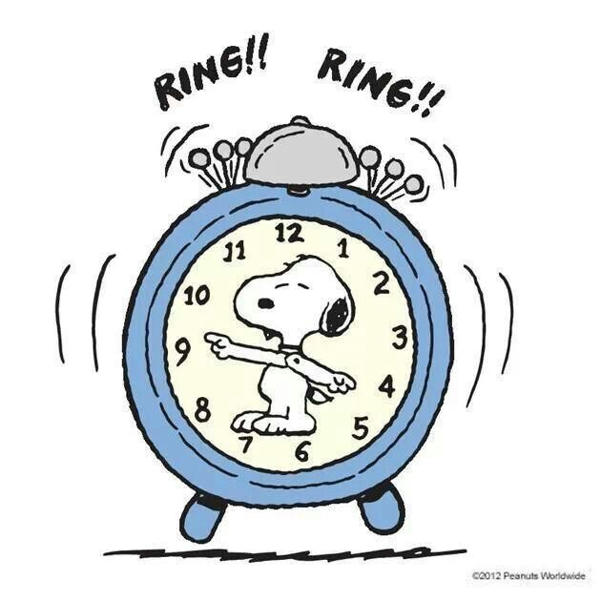
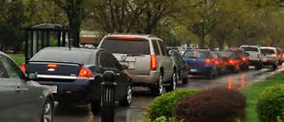
Why scooting, cycling or walking is good:
Notes:
Summaries each reason for why walking, cycling or scooting is good.
Good for the planet, saves us money, its good for our heart, its good for our mental wellbeing and mood, it can save us time and it stops congestion especially around the school gates.

Slide 10
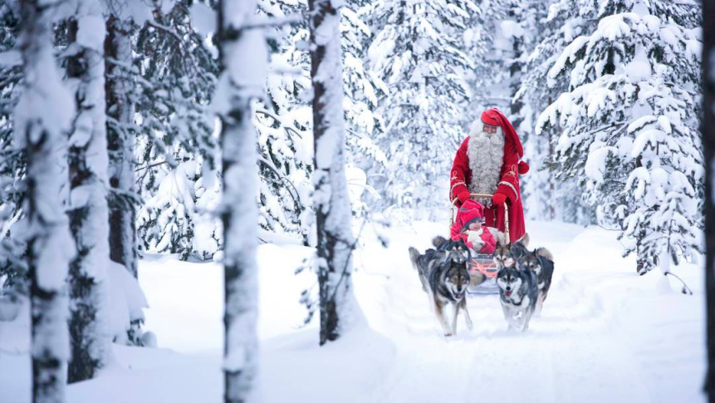
The Santa Challenge: to travel to Lapland!
Each time you walk, cycle or scoot to school over the next two weeks it counts as 1 mile.
It is over 2,000 miles to Lapland
Monday 28th November and Friday 9th December 2021
Parents travelling actively count too
Notes:
It is over 2,000 miles to Lapland so you’ll have to work together to reach Santa

Slide 11
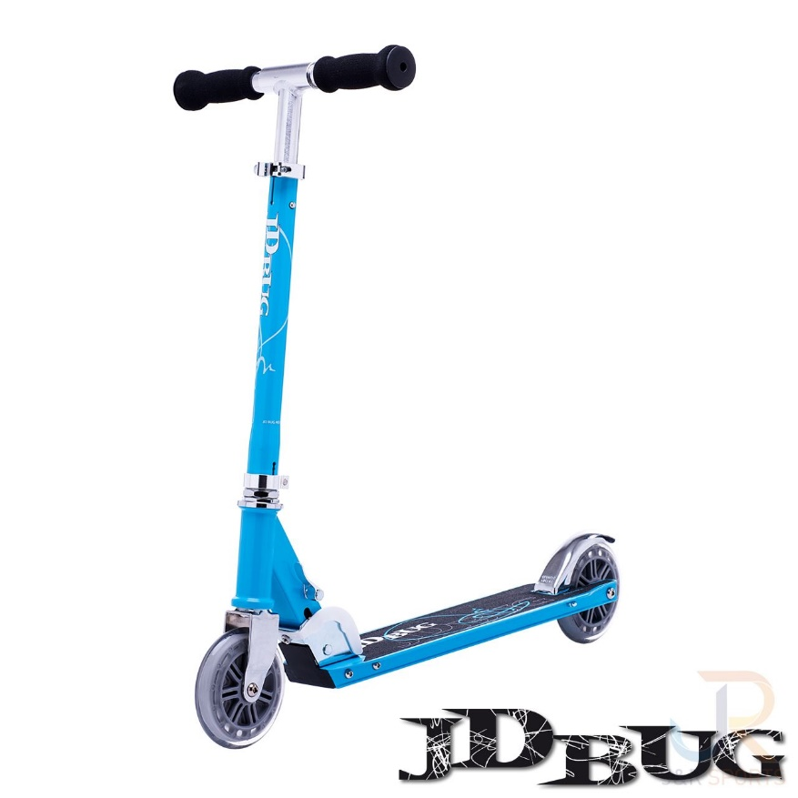
Prize Scooter
If you record more than 20 miles over the two weeks you’ll be entered into a prize draw and one of you will win a scooter!!!
Document title | 21 November 2022

Slide 12
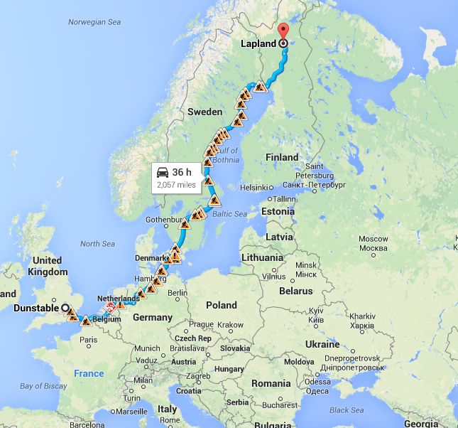
Your School to Lapland
France
Belgium
The Netherlands
Germany
Denmark
Sweden
Notes:
On your virtual journey to Santa you will pass through France, Belgium, the Netherlands, Germany, Denmark and Sweden.

Slide 13
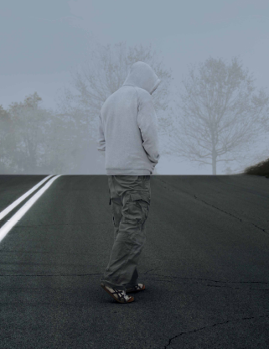
It’s getting darker earlier
Grey and dark days
+
Grey and dark clothing
=
INVISIBILITY

Slide 14
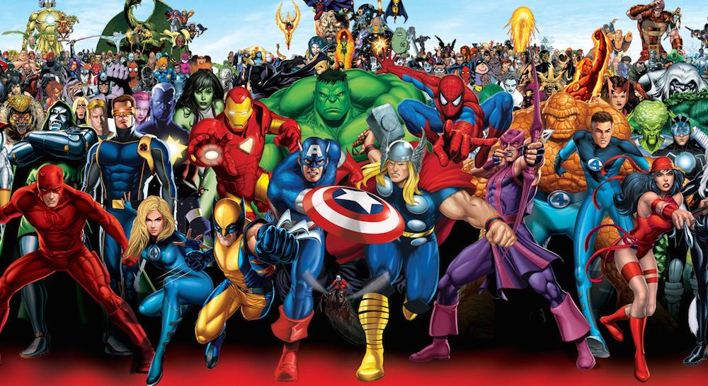
BE SUPERHERO BRIGHT

Slide 15
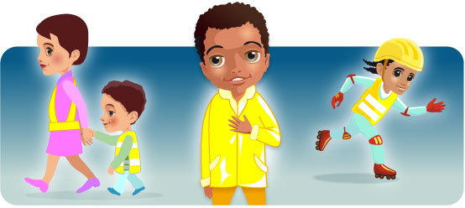
Don’t forget when out and about in these darker days
Be Bright Be Seen
Notes:
Road safety is all about looking – it is THE most important thing, even in wintertime
We know it’s important to use our eyes and ears when we cross the road. What else can we do to make ourselves safer near traffic?

Slide 16
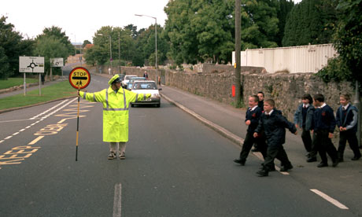
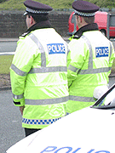
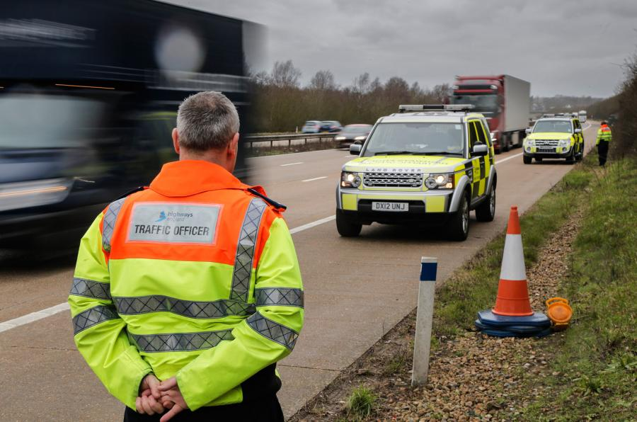
What do people that work near roads wear?

Slide 17
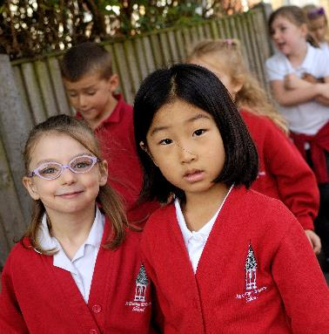
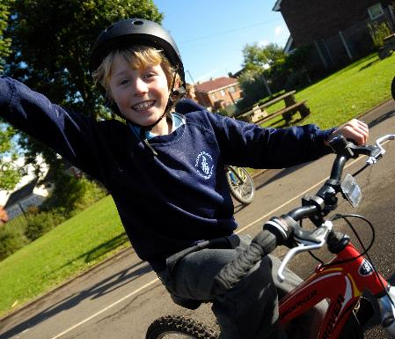
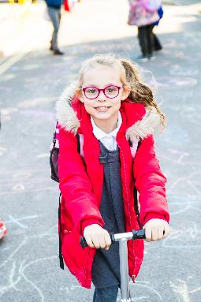
Don’t forget
Santa Challenge
Monday 28th November to Friday 9th December
Keep walking, cycling and scooting to school

Slide 18
How can you be seen more easily?
On dull days wear bright or fluorescent colours
Fluorescent armbands can also be worn over coats and other clothing. Bags can be bright colours or with high-visibility strips
2. If walking near traffic at night reflective clothing is needed. Reflective clothing reflects light from car and bike headlamps. Reflective armbands are easy to buy.
Remember that fluorescent colours do not show up in the dark
Notes:
Check they understand the difference between fluorescent (needs light to be seen) and reflective which will shine the light back when a car or bike light is shone on them.

Slide 19
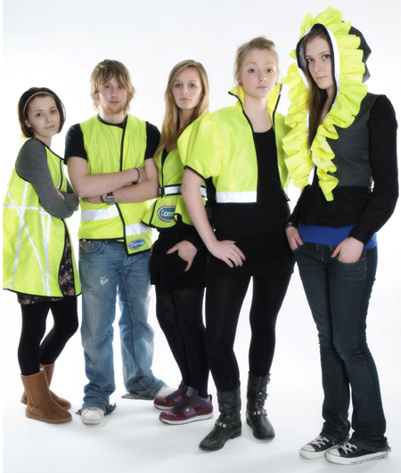
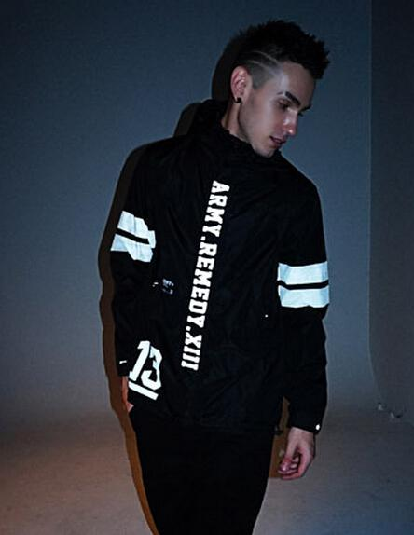
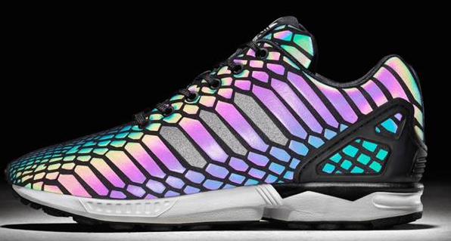
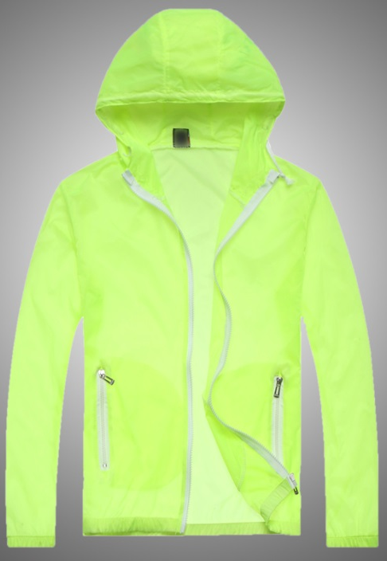
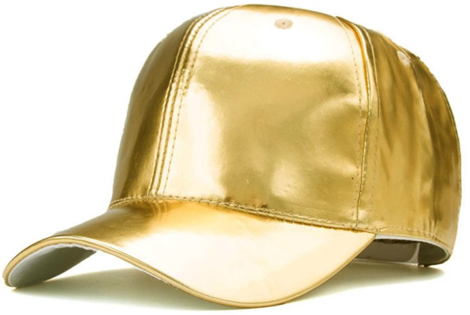
What can we do?
Dress bright!
Notes:
Dress light and bright

