Slide 1
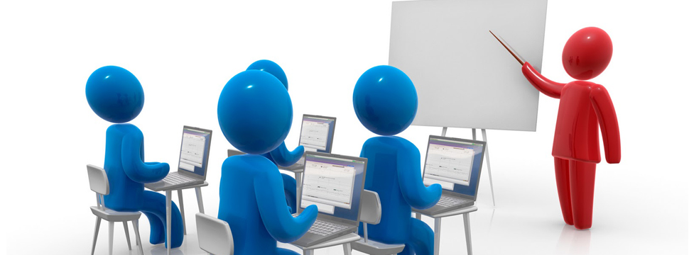
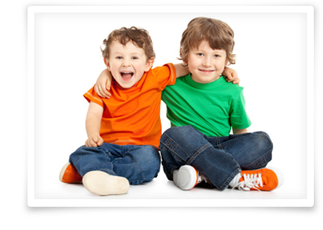
Everyone’s rights…
The right to learn
The right to be happy
The right to be safe
The right to be included

Slide 2
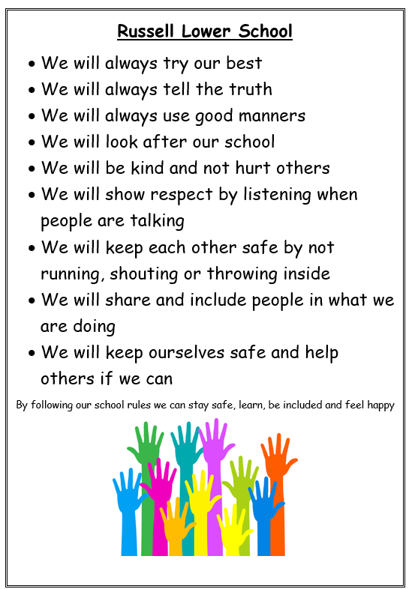
What is the same at school? Expectations!

Slide 3
The right to be safe

Slide 4
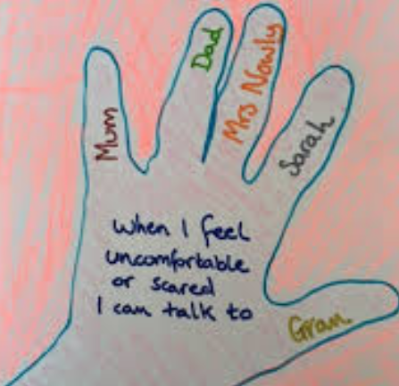
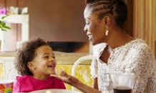
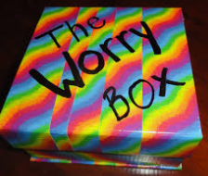
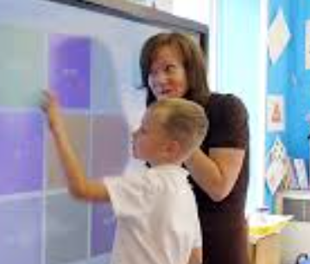
What do I do when I don’t feel safe?

Slide 5
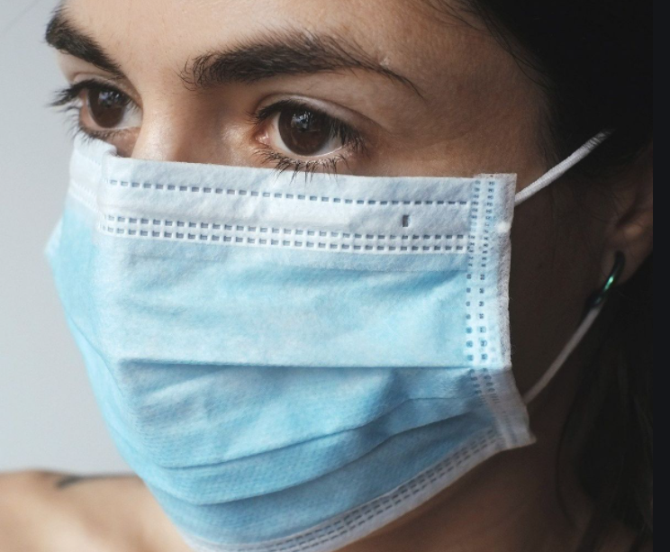
What if a lot of Covid comes back?
We might need adults to wear face coverings again
We might need to make class ‘bubbles’ again
We might need to go back to some of the things we did before
You might have a bit of a cough
You might feel a bit sleepy
You might feel a bit hot (have a temperature)
You might have a headache
No problem! You will feel better really soon

Slide 6
