Slide 1
Parent Workshop - Phonics
Tuesday 22nd September 2020

Slide 2
Aims for today’s session
To explain what phonics is.
To give you all the information you need, in order to understand why and how we teach your child phonics.
To give you information about the statutory phonics screening check.
We will also give you ideas for how you can support your child at home with phonics.

Slide 3
Where did it all start?
Rose Review – Educational Study 2006: ‘High Quality Phonics Work’ needed for a sound base for reading and writing.
Introduction of a daily phonics lesson for children.
Introduction of ‘Letters and Sounds’ teaching booklet.
Two dimensions ‘Word Recognition’ and ‘Language Comprehension’. Language development and phonics working together supports reading development.
Key skills – ‘Segmenting’ and ‘Blending’.

Slide 4
What is phonics?
Phonics is a way of teaching children how to read and write. It helps children hear, identify and use different sounds that distinguish one word from another in the English language.
Written language can be compared to a code, so knowing the sounds of individual letters and how those letters sound when they’re combined will help children decode words as they read.
Understanding phonics will also help children know which letters to use when they are writing words.

Slide 5
Introduction
We follow the ‘Letters and Sounds’ programme. Letters and Sounds is a phonics resource published by the Department for Education and Skills which consists of six key phases.

Slide 6
Terminology
Phoneme – the smallest unit of sound in a word.
Grapheme – a letter or group of letters that represents a sound (the letter shape).
Segmenting – breaking down the sounds (sounding out) and then Blending - putting all the sounds back together again to say the whole word.
Digraph – two letters making one sound, e.g. ch/sh/th/ai/ee.
Trigraph – three letters making one sound, e.g. igh/ear.
Split digraph – words containing the long vowel sound: a-e, e-e, i-e, o-e, u-e, where the ‘e’ makes the short vowel sound a long sound instead.
Abbreviations – ‘GPC’ grapheme-phoneme correspondence- the relationship between the letter sounds and their shapes.

Slide 7
A phased approach for a range of learners: Phase 1
Provides a rich and varied language experience, to develop children’s word knowledge and command of dialogue.
-There are 7 aspects:
A1 – Environmental Sounds
A2 – Instrumental Sounds
A3 – Body Percussion
A4 – Rhythm and Rhyme
A5 – Alliteration
A6 – Voice Sounds
A7 – Oral Blending and Segmenting

Slide 8
Phase 2 -
Start of systematic phonic work and teaching of the alphabet. Learning to pronounce sounds in response to letters, read and spell vc words ‘it’ and cvc words ‘bin’.
Set 1: s, a, t, p
Set 2: i, n, m, d
Set 3: g, o, c, k
Set 4: ck, e, u, r
Set 5: h, b, f, ff, l, ll, ss

Slide 9
Phase 3
Learning sounds represented by more than one letter (mainly) and read and spell cvc words ‘bag’.
Set 6: j, v, w, x
Set 7: y, z, zz, qu
Consonant Digraphs: ch, sh, th, ng
Vowel Digraphs/Trigraphs: ai, ee, igh, oa, oo, ar, or, ur, ow, oi, ear, air, ure, er

Slide 10
Phase 4
Learning to read and spell words with adjacent consonants.
This phase consolidates all that the children have learnt in the previous three phases.
Children represent each of the 44 phonemes with a grapheme.
They will segment and blend phonemes to read and spell cvcc words ‘best’, ccvc words ‘frog’, ccvcc words ‘thank’, cccvc ‘scrap’ and cccvcc words ‘scrunch’.
They will also be able to read simple two syllable words, e.g. ‘lunchbox’ .

Slide 11
Phase 5
Children will be taught new phonemes and many alternative graphemes and pronunciations for phonemes taught in Phase 3.
Vowel Digraphs: wh(w), ph(f), ay/ai, ou/ow, ie/igh, ea/ee, oy/oi, ir/ur, aw/au, ew/ue, ow/oe.
Split Digraphs: a_e, e_e, i_e, o_e, u_e

Slide 12
Phase 6
The focus is on securing the reading and spelling of Phase 5 words and progressing to the learning of spelling rules for suffixes (word endings).
This continues in to and throughout Year 2.
-s -es -ing -ed
-er -est -y -en
-ful -ly -ment
-ness

Slide 13
https://home.oxfordowl.co.uk/reading/learn-to-read-phonics/

Slide 14
Segmenting
Breaking down the individual sounds/digraphs for speaking, reading and spelling a word.
cat
c a t

Slide 15
Segmenting
Queen
Qu ee n

Slide 16
Blending
Putting all the sounds back together again, to say/read/spell the whole word.
c a t
cat

Slide 17
Blending
Qu ee n
Queen

Slide 18
What does a high quality Phonics session look like at RUSSELL LOWER?
Revisit/Revise | Songs and flashcards to practice phonemes/graphemes learnt so far.
Teach | Teach new phoneme, e.g. ‘air’
Practice | Read and Spell, e.g. play ‘Buried Treasure’ – identify real and non- words containing the focus phoneme: air, zair, fair, hair, lair, pair, vair, sair, thair
Apply Assess and Review | - Read and write sentences with focus phoneme/s: The girl had a long hair. The boy played hook a duck at the fair. - Check knowledge and understanding of the teaching and learning focus via games and fun techniques.

Slide 19
Ofsted findings– ‘the best schools…’
Ensure active involvement from pupils – make sure each session is varied and fun .
Detailed assessments and tracking in place, half termly.
A consistent and organised approach.
Opportunities to develop reading, writing and spelling within a session.
Successful sessions have…clear structure, fast pace, praise and reinforcement.
A ’committed’ whole school approach, e.g. all teachers follow the same lesson structure and games.

Slide 20
Year 1 Phonics SCREENING CHECK
The Year 1 phonics screening check is not a formal test (it is statutory), but a way for teachers to ensure that children are making sufficient progress with their phonics skills to read words and that they are on track to become fluent readers who can enjoy reading for pleasure and for learning.
Year 1 children usually take the phonics screening check in early June. However, due to school closures the check did not take place this year. Instead, schools are required to use a past version of the check with Year 2 pupils in November or December 2020.

Slide 21
Our current Year 1 pupils will complete their screening check in June 2021. Any Year 2 children who do not pass the screening check before Christmas will then be asked to complete the screening check in June 2021, alongside the Year 1 children.
There are two sections in the 40-word screening check and it assesses phonics skills and knowledge learned through Reception and Year 1. Your child will read up to four words per page for their teacher and they will probably do the check in one sitting of about 5–10 minutes.

Slide 22
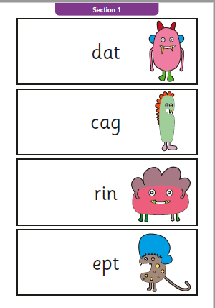
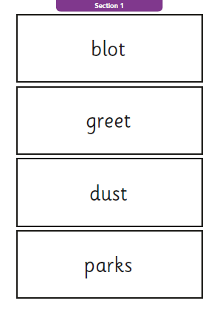
Year 1 Phonics screening sample

Slide 23
ACTIVITIES TO TRY
Blending
Segmenting
Speed Spelling
Rhyming Games
Alliteration Games
Rainbow Writing
Buried Treasure
Sentence Substitution and Word Matching
Word Sorting
Snap
Dictation
Sounds Bingo
Beat the Timer
Matching Pairs
‘I Spy’ – Using graphemes and phonemes
Writing silly sentences

Slide 24
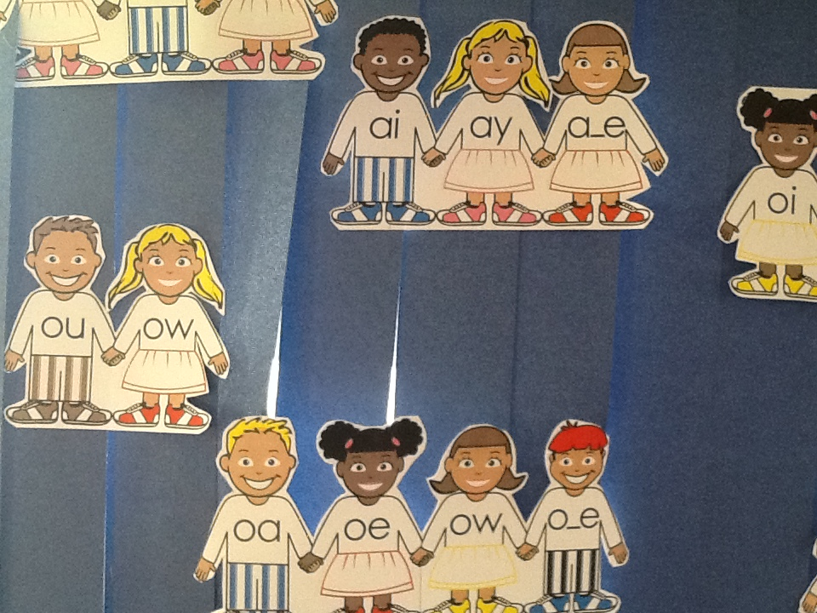
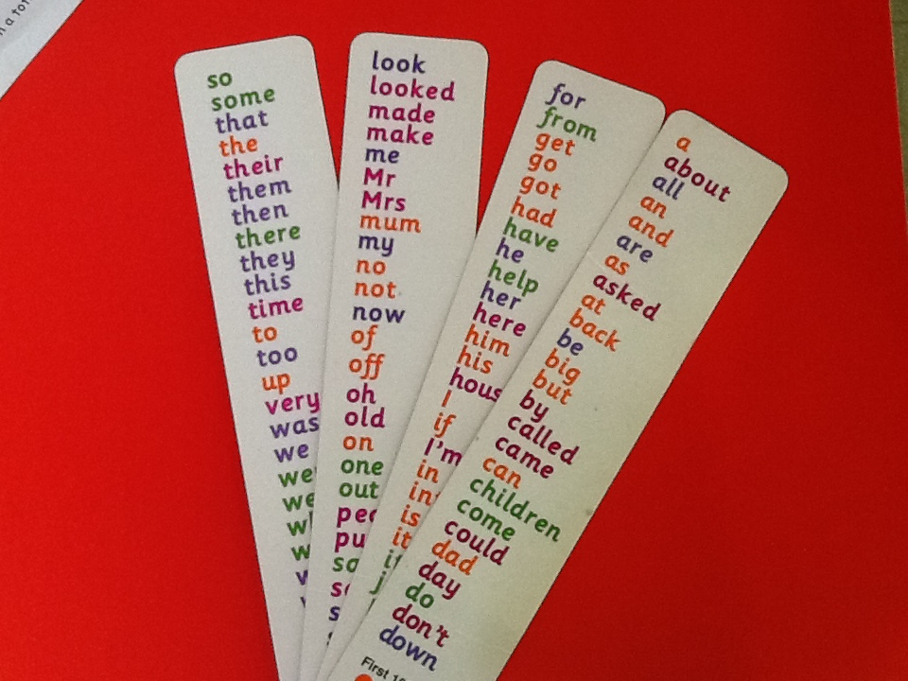
Classroom resources and support

Slide 25
Useful resources for home
Whiteboards/Pens
Magnetic Letters
Phoneme Cards/Mats
Key Word Flashcards
Timer
Colour Pencils
Games/Fun Activities
Reading Books

Slide 26
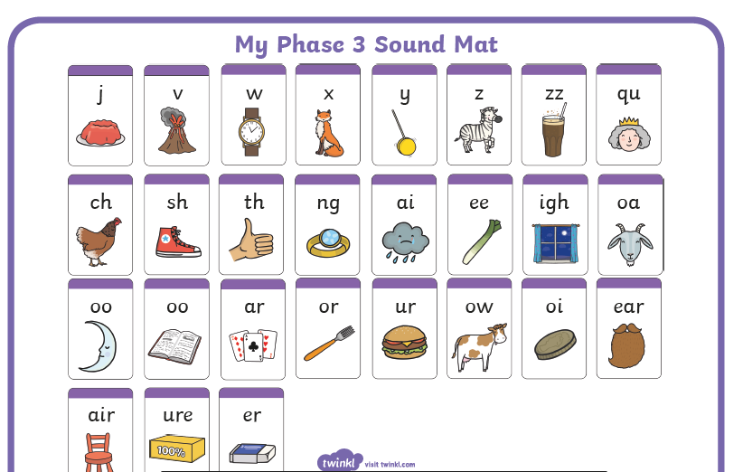
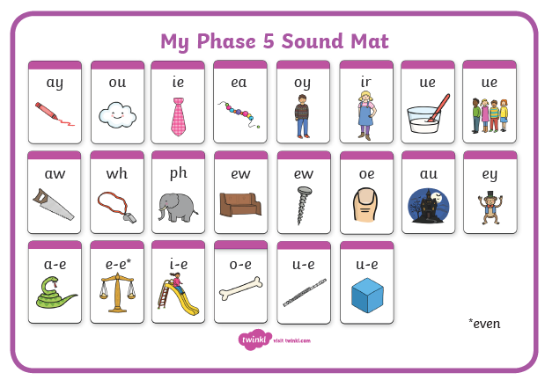

Slide 27
Useful online resources
http://www.phonicsplay.co.uk

Slide 28
Continued…
http://www.twinkl.co.uk/ – useful resources, e.g. phoneme and word cards and mats
http://www.letters-and-sounds.com/Has lots of information, printable resources for each of the Letters and Sounds phonic phases, and also links to games aligned with each phase.
http://www.phonicsplay.co.uk – fun games which link to Letters and Sounds
https://www.phonicsbloom.com/ This website has some free phonic games to access at home.
http://ictgames.com/literacy.html This website has a range of fun phonic games to play together.

Slide 29
Thank you for taking the time to watch this presentation.
DO YOU HAVE ANY QUESTIONS?
Please feel free to contact me
‘Mrs Jochacy’ through my class email address
wrenclass@russell-lower.co.uk
If you have any questions about what you have heard today or would like any advice on resources to support your child.
If you have any questions linked more to your child’s phonic progress then please email your child’s class teacher.

