Slide 2
Here is a public announcement on behalf of Santa…

Slide 3
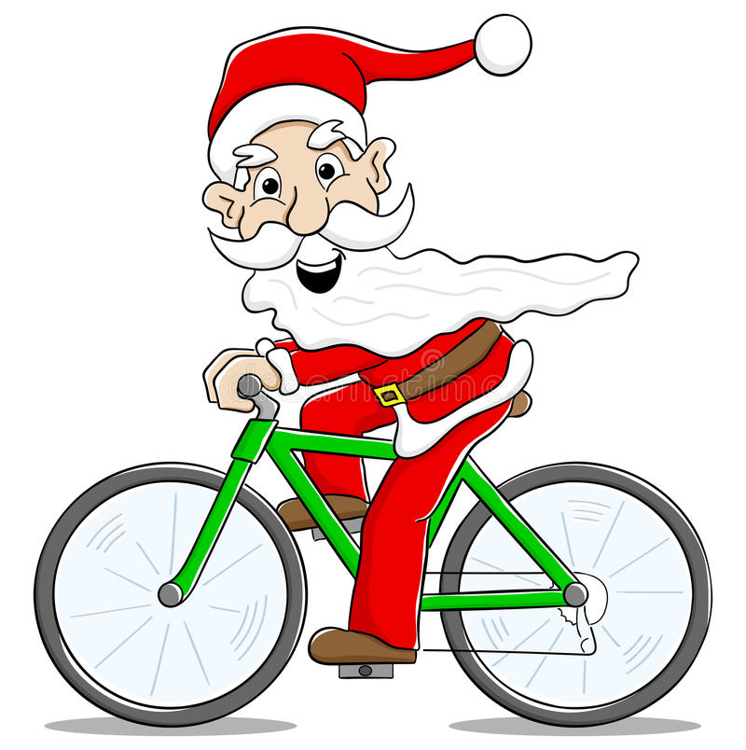
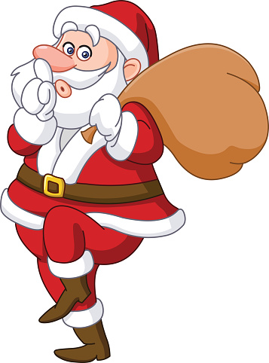
Did you manage to join my challenge?

Slide 4
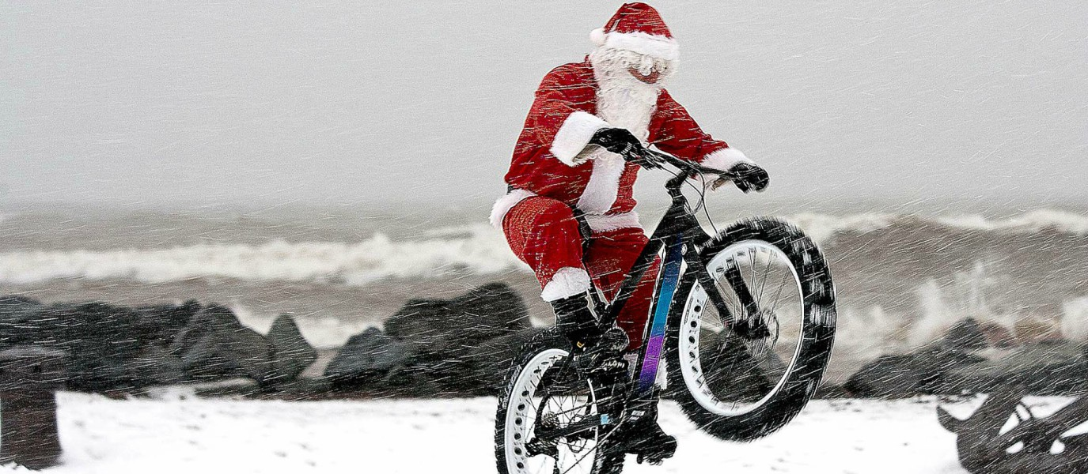
The Santa Challenge:
You were asked if you could to walk, cycle or scoot to school over the past two weeks and every journey you and your parents/guardian completed counted as 1 mile in your virtual journey to Lapland.
Lets see how you got on…

Slide 5
Bedfordshire to Lapland
Your target was to get to my home in Lapland 2,027 miles away.
I am delighted to announce Russel Lower School
made it all the way there and home with a total of
5,679 virtual miles
Well done to everyone especially the 172 pupils who completed all 10 days.
That is a great achievement!

Slide 6
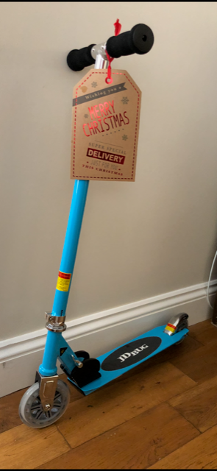
Do you remember?
If you completed all 10 days
of the challenge over the past
two weeks you were entered
into a prize draw to win this
scooter!

Slide 7
And the winner is!
Well done
__________
I hope you have lots of fun with your scooter.

Slide 8
I’d also like to say a big thank you to your teachers.
They have done a great job this year, I think they deserve a big clap.
But before I go I’d like to remind you, this time of year is cold, wet and dark outside.

Slide 9
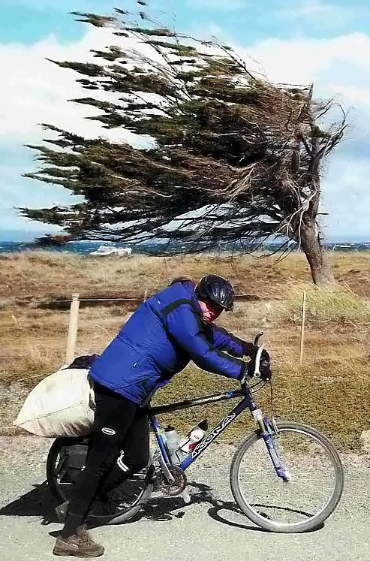
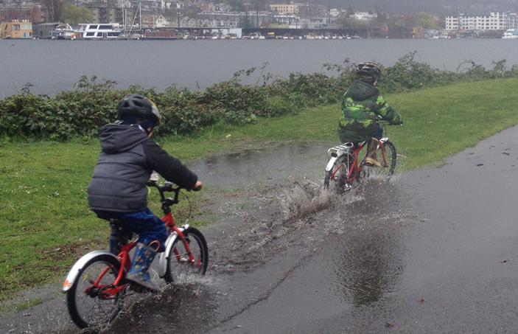
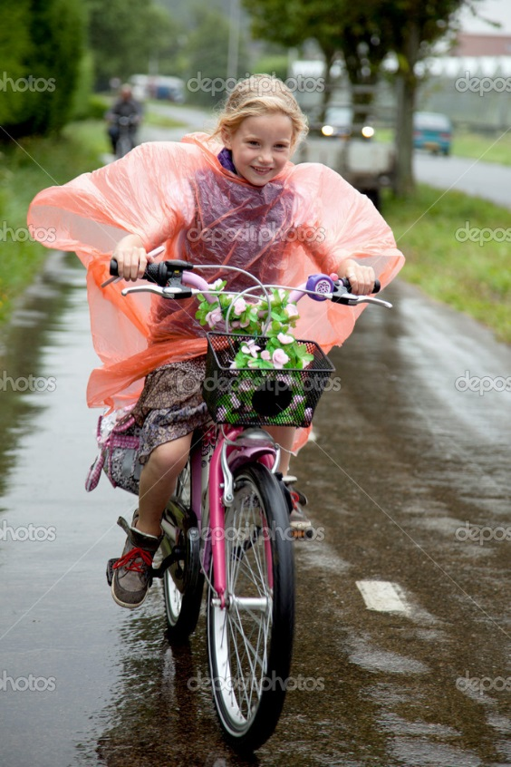
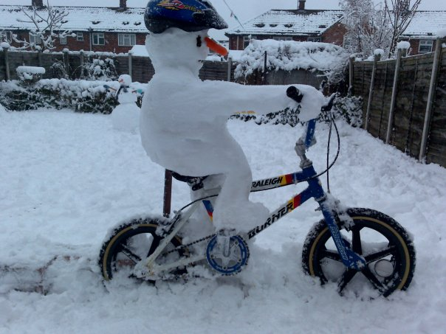
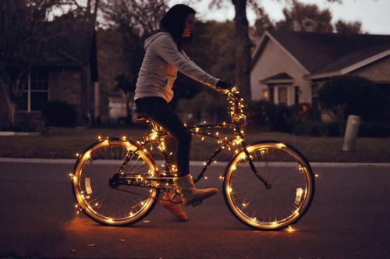
Wet
Cold
Dark
Notes:
Ask the children what month it is – what season it is – and that the weather is like at this time of year?
Wet
Cold
Dark

Slide 10
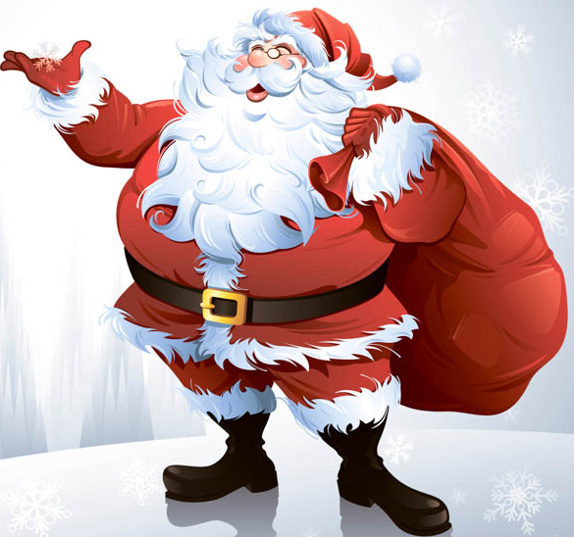
So be like me, be bright be seen!
Happy
Christmas !

