Slide 1
5 to thrive
Children In need day 2020

Slide 2
Thrive

Slide 4
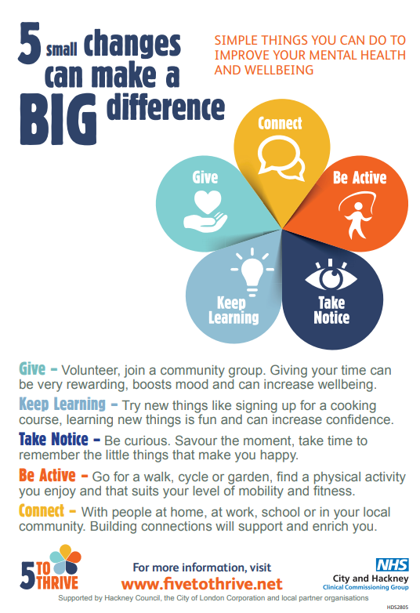

Slide 5
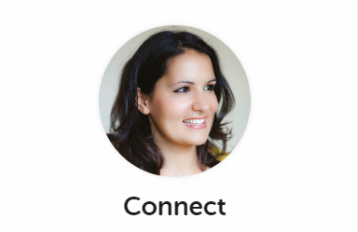
Connect
What makes a good friend?
How do we keep our friends?

Slide 6
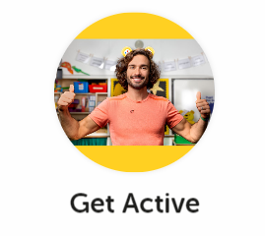
Be active
How do you keep active?
Make it fun!

Slide 7
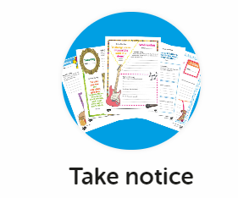
Take Notice
Take notice of how you feel.
What happens to your body when you are frightened? Happy? Tired? What can you do about it?
Enjoy noticing natural things outside – sunset, squirrels, leaves changing colour etc.
Mindfulness
STOP and take a breath – use your senses

Slide 8
Keep learning
Growth mindset – the power of yet!
Try something new – be curious
Never give up
Research something that interests you

Slide 9
Curious

Slide 10
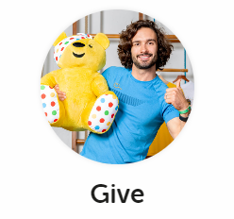
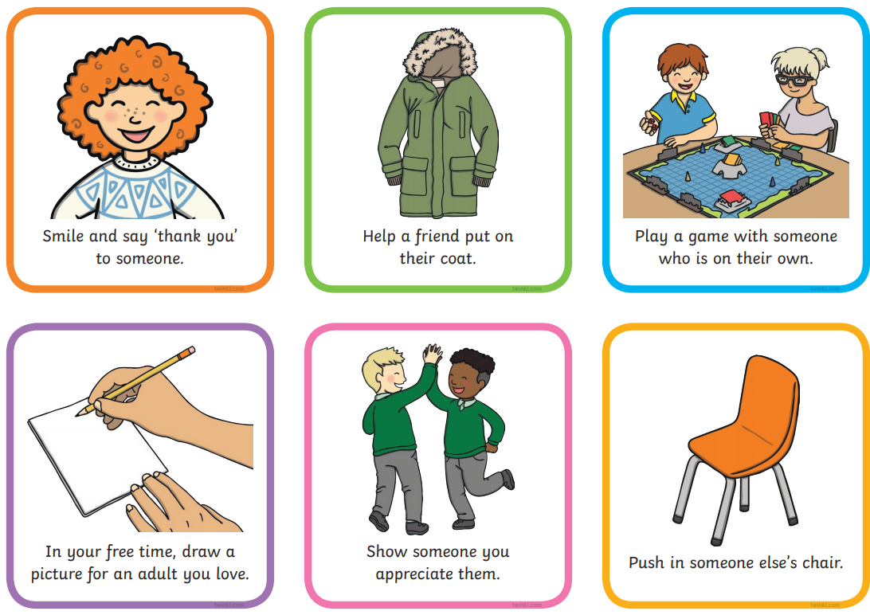
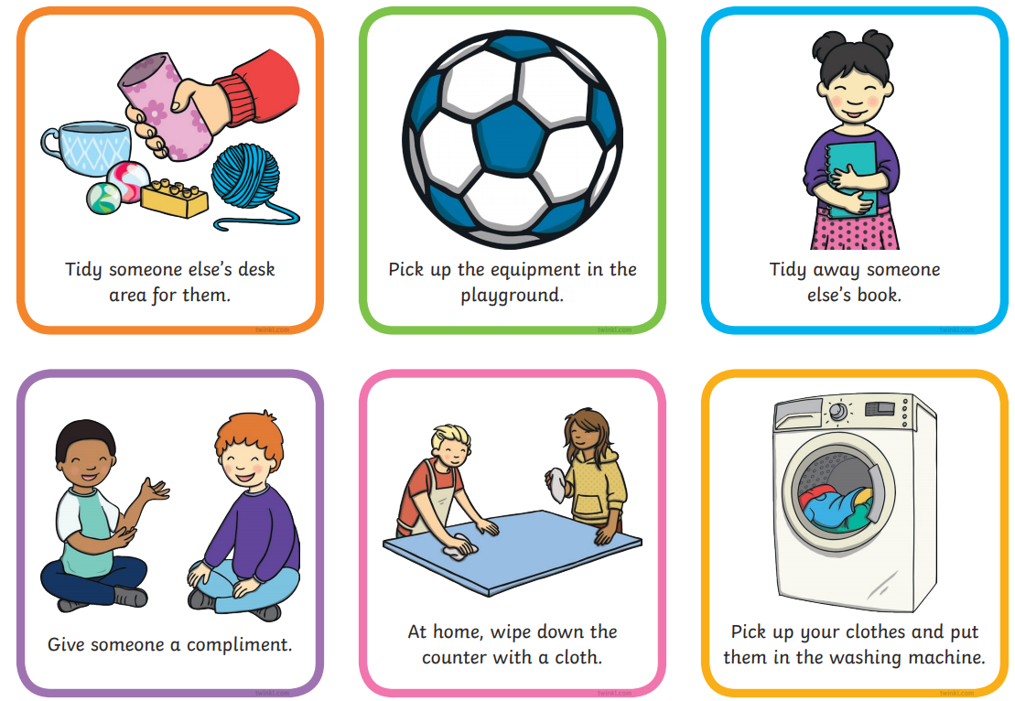
Give

Slide 11
What will you do?

Slide 12
5 to thrive came from the Five Ways of Wellbeing for grown ups. We need the same things!

